Slide 1
Control Engineering
Lecture 1

Slide 2
Eva.Dulf@aut.utcluj.ro

Slide 3
What is control?
To cause a machine or process to function in a predetermined manner
To energize and de-energize an output, or to set a data table bit or bits to on or off, by means of a user program

Slide 4
What is a controller?
A circuit that excepts inputs
  one input is the action (command signal)
  the other one is the measurement signal (feedback / feedforward)
  Compares these inputs and determines the output reaction
A unit that controls a machine or process

Slide 5
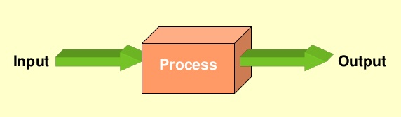
What is a control system?
An interconnection of components forming a system configuration which will provide a desired system response

Slide 6
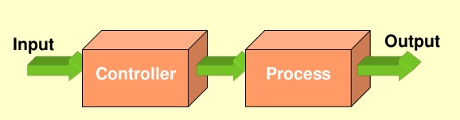
Open loop control system
A control system that has no means of comparing the output with the input for control purposes

Slide 7
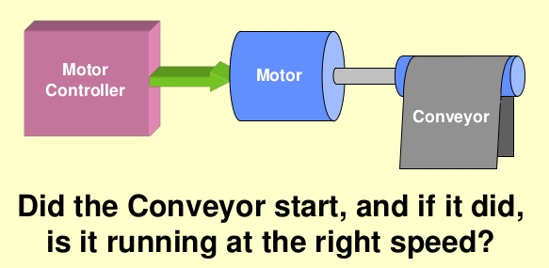
Open loop control system

Slide 8
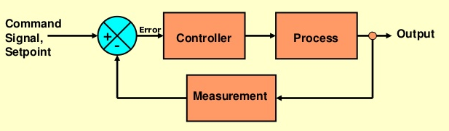
Closed loop control system
Uses an additional signal that measures the actual output with the desired setpoint which in turn adjusted the controller to produce the desired output

Slide 9
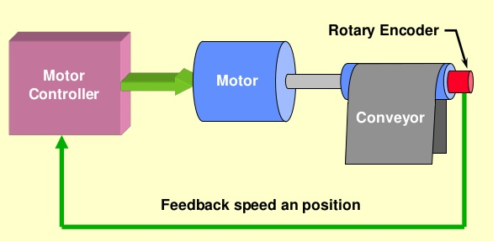
Closed loop control system

Slide 10
Outline of the course
Time-Domain Analysis of Control Systems
Frequency-Domain Analysis of Control Systems
PID controllers
Controller design methods:
  Time domain design methods
  Frequency domain design methods
  Quasi-optimum and optimum design methods
  Industrial design methods
Special control structures
  Cascade control
  Dead time compensation
MIMO systems

Slide 11
References
R.C. Dorf, R.H. Bishop, Modern Control Systems (12th Edition), Prentice Hall; 2010
K. Ogata, Modern Control Engineering, Prentice Hall, 2010
K. J. Astrom, R. M. Murray, Feedback Systems: An Introduction for Scientists and Engineers, Lund Institute of Technology, 2006
D. Xue, YQ. Chen, D.P. Atherton, Linear Feedback Control. Analysis and Design with MATLAB, SIAM, 2007
Q-G. Wang, Z. Ye, W.-J. Cai, C-C. Hang, PID Control for Multivariable Processes, Springer, 2008
A. O*Dwyer, Handbook of PI and PID Controller Tuning Rules, Imperial College Press, 2006
B.J. Lurie, P.J. Enricht, Classical Feedback Control with Matlab abd Simulink, CRC Press 2014

Slide 12
Evaluation
Course Acquired knowledge+Course activity - Written exam 70%
Acquired practical skills+Labor activity - Oral exam 30%
Minimum standard of performance
  Exam grade>5
  Laboratory grade>5

